Slide 1

Data Augmentation
Data SAIL Club – Spring 2026

Slide 2
What is it?
Technique used to artificially increase the size and diversity of a training dataset by creating modified versions of existing data.
Enables models to learn invariant features, such as recognizing a cat regardless of its orientation or lighting, by exposing them to varied but realistic input variations.
Widely used in computer vision, natural language processing and audio processing.
Augmented data is derived from real data through transformations (while synthetic data is generated from scaratch

Slide 3
Mostly.ai
https://mostly.ai/
Augment your data from the previous meeting and try to improve your model’s performance.

Slide 4
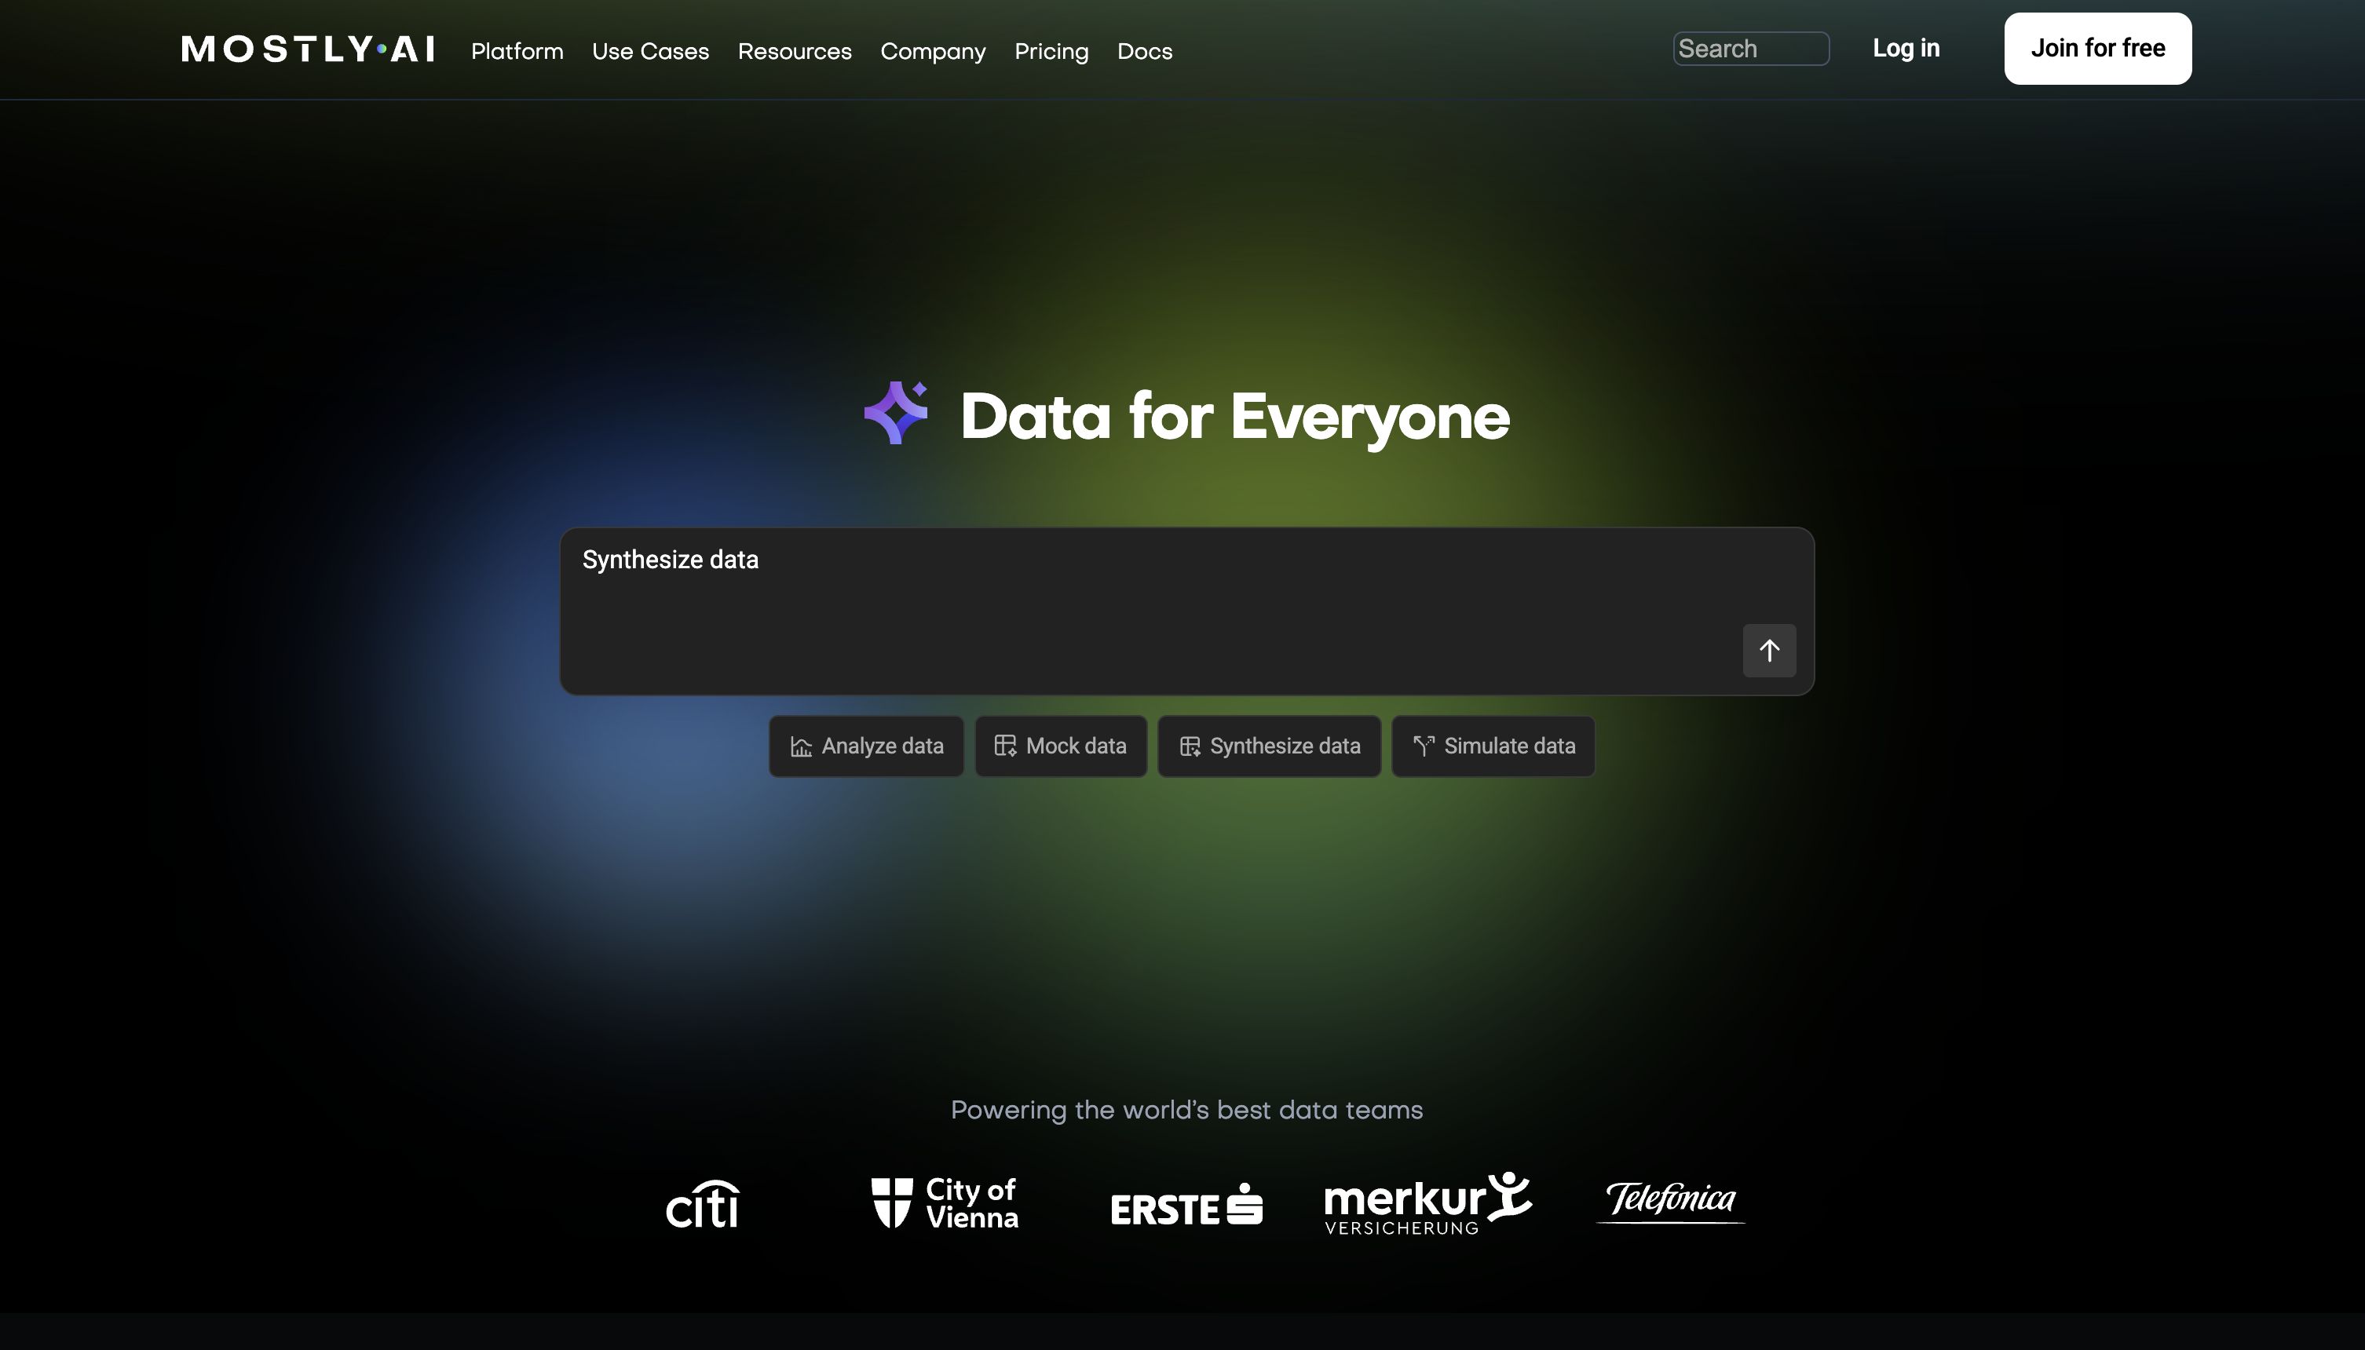
Create an account

Slide 5
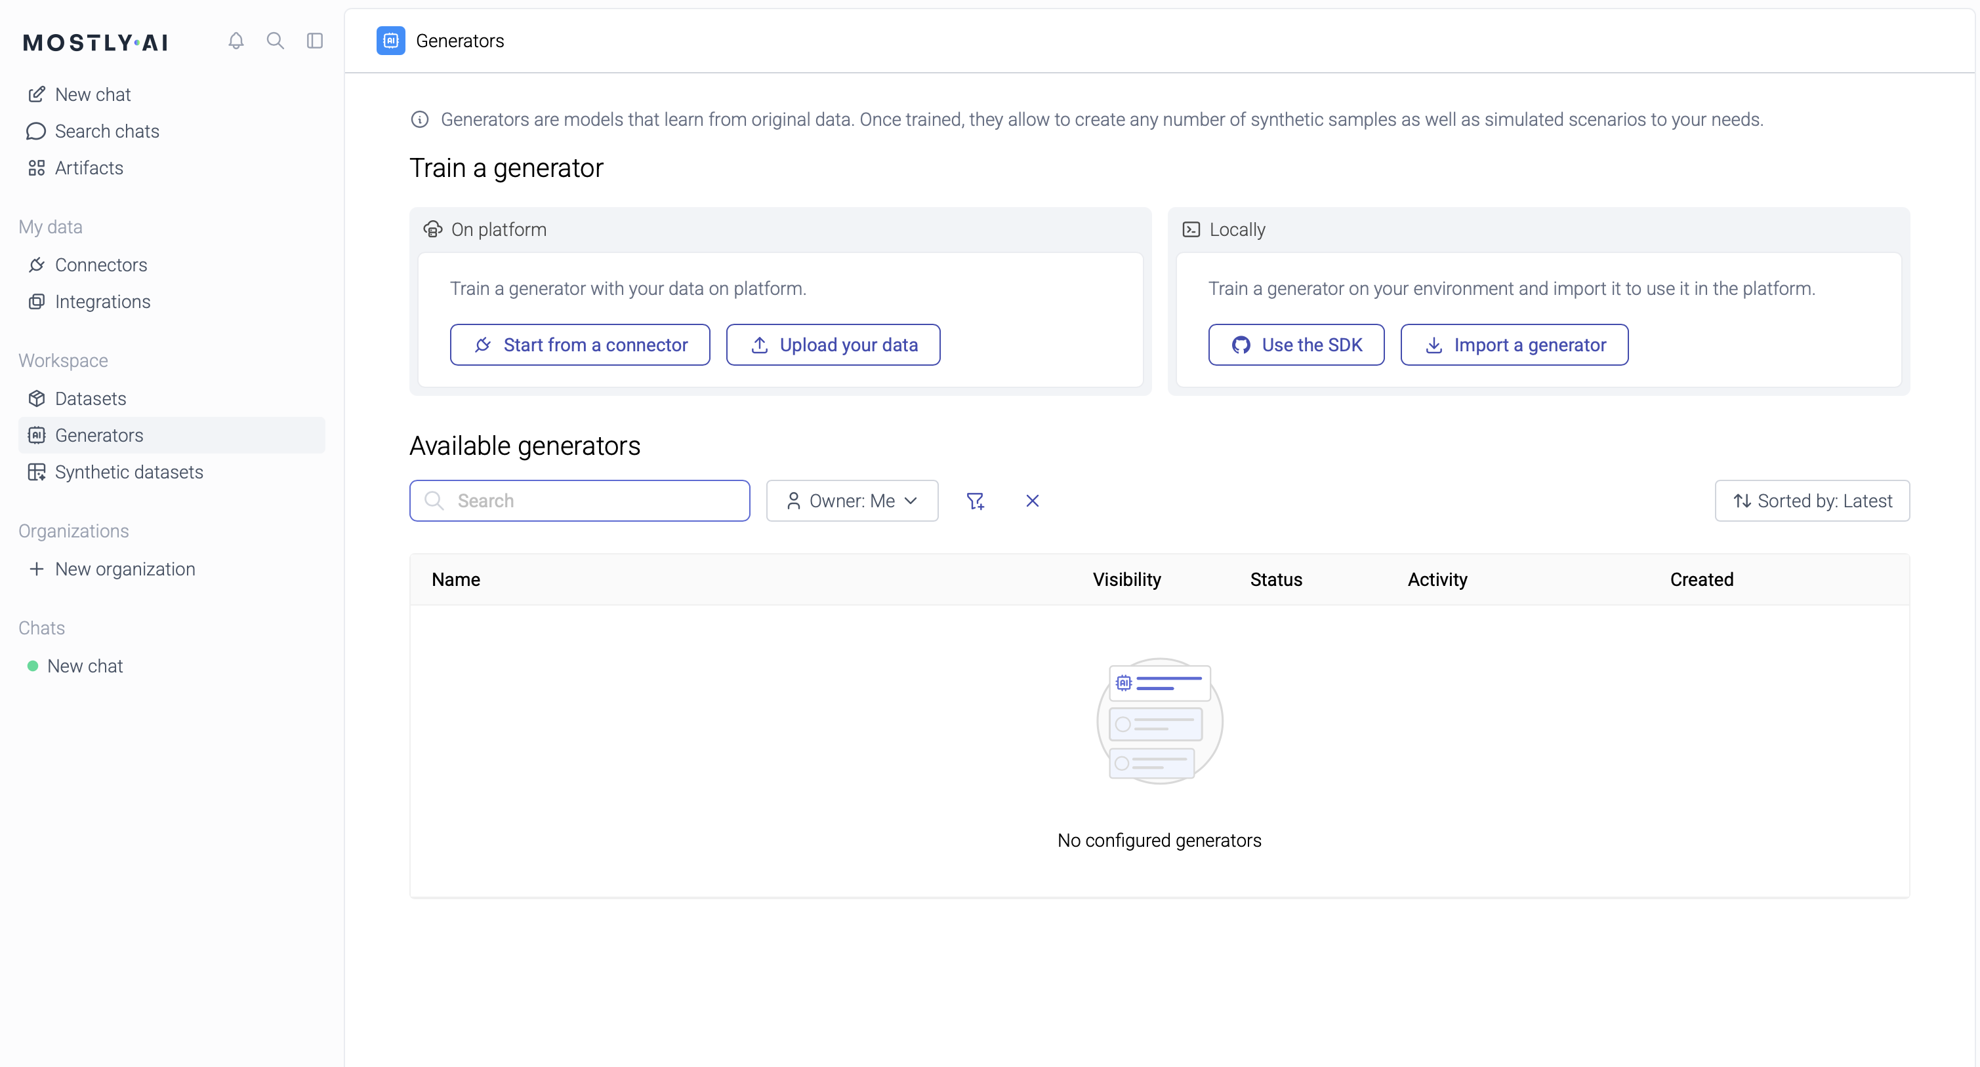
Upload your dataset

Slide 6
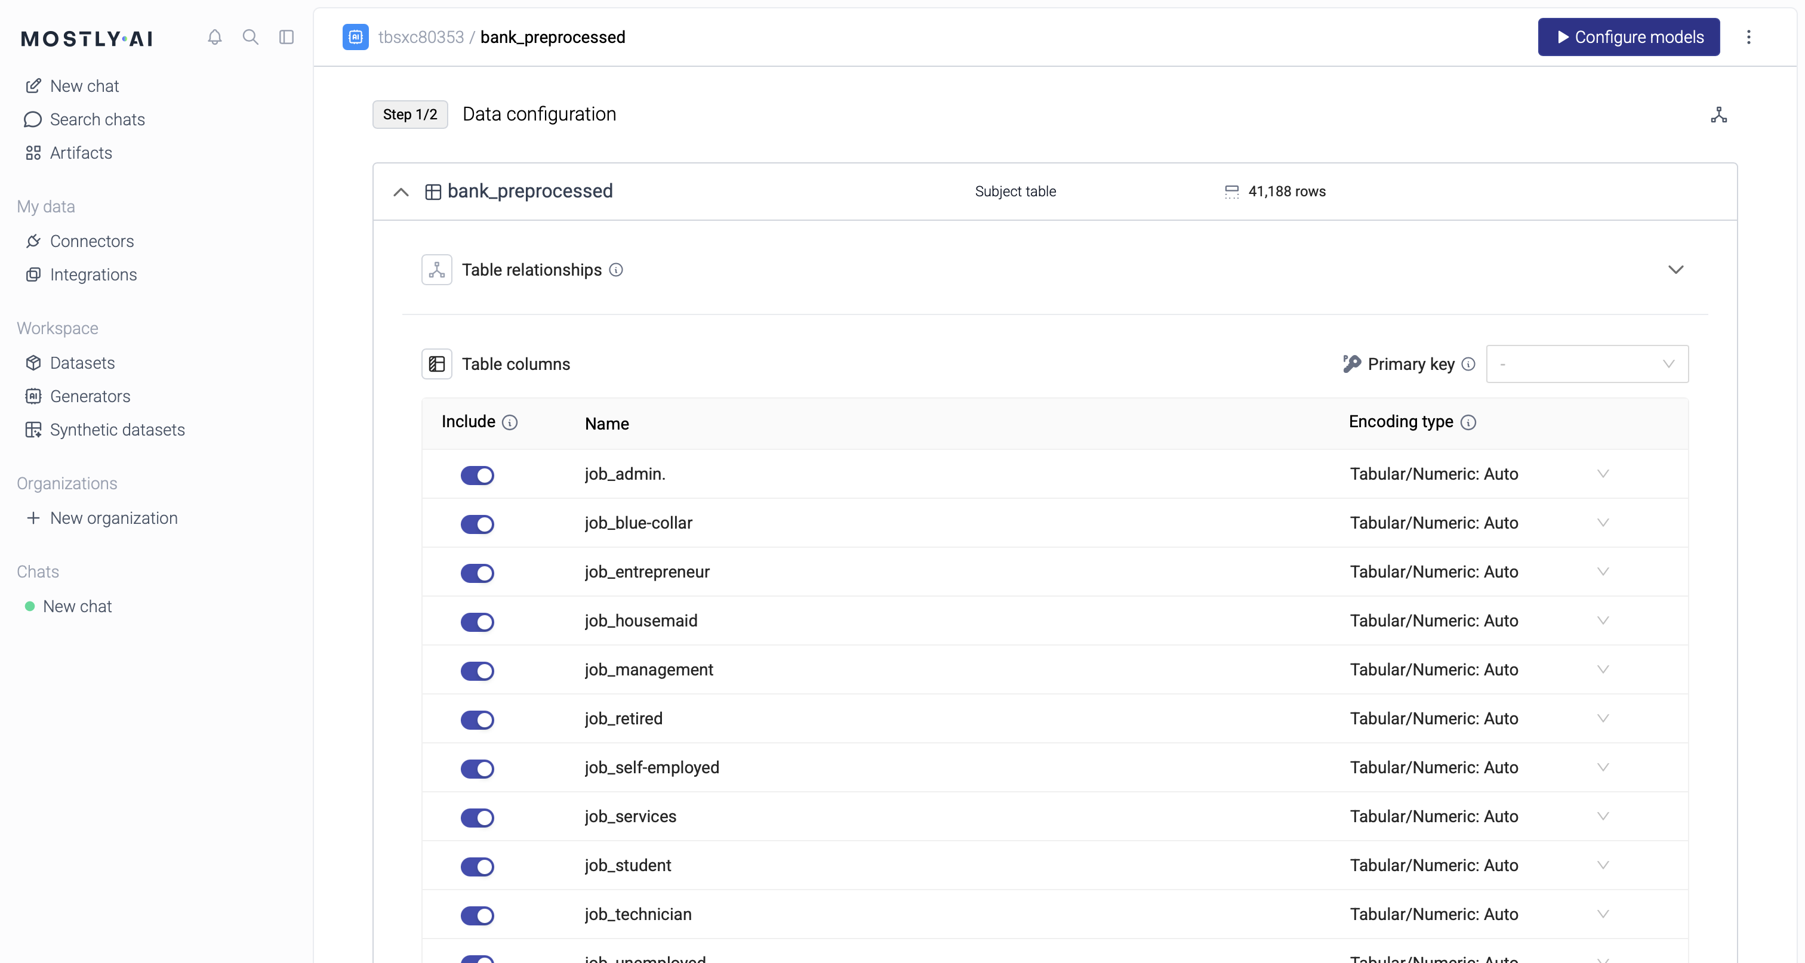
Configuration settings (default)

Slide 7
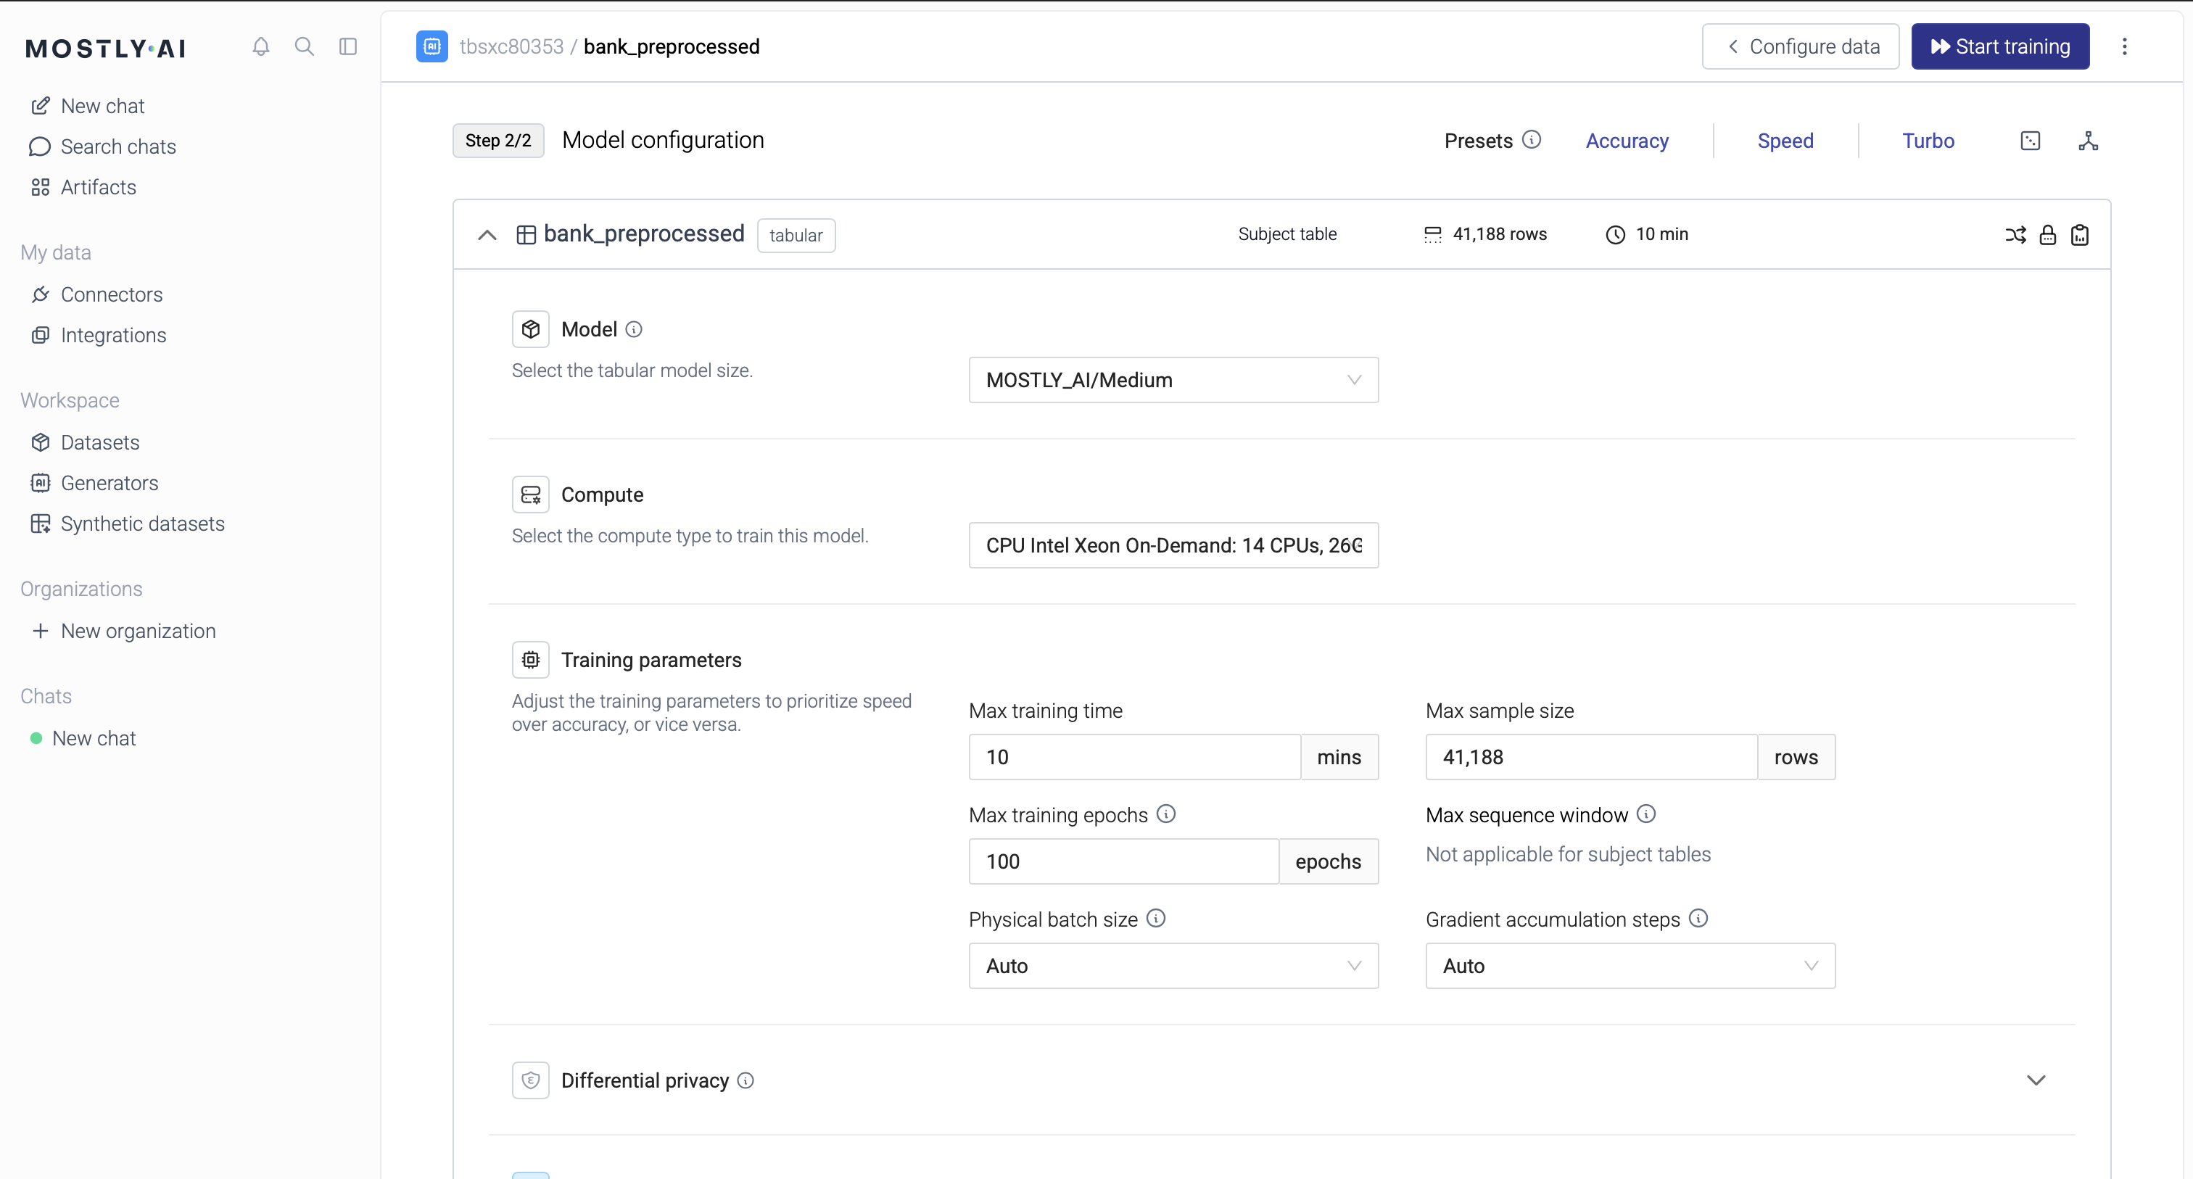
Model configurations (default)

Slide 8
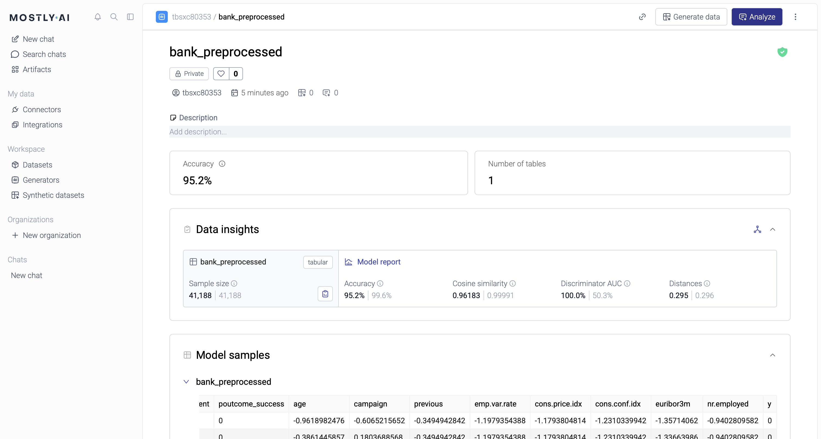
Generate data and reports

